Slide 1
Gene Set Enrichment
Modified from: Maureen Sartor

Slide 2
Learning Objectives
To learn how to determine whether a particular pathway or set of genes that an observation affects is significant

Slide 3
Functional Enrichment Testing (also called Gene Set Enrichment Testing)
What pathways or biological processes were affected in my experiment?
What biologically related sets of genes are enriched with differential expression/binding from my
RNA-seq/microarray/ChIP-seq
experiment?

Slide 4



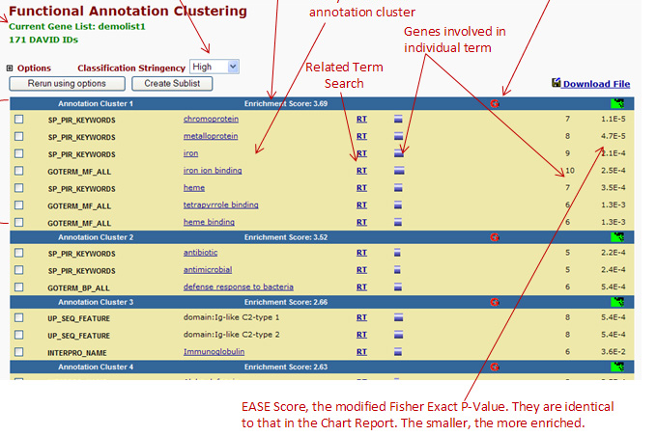
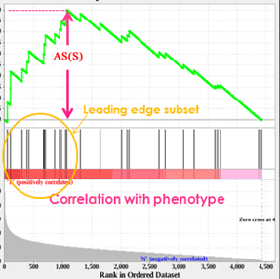
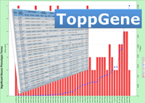
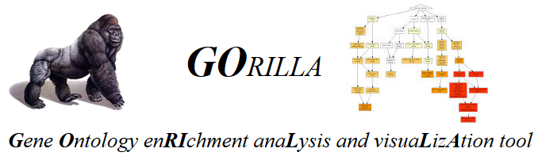


Dozens of programs for functional enrichment testing…
GSEA
SeqGSEA
GOseq
…and many more

Slide 5
Gene Set Types
MiMI protein interactions
biological process
molecular function
cellular component
KEGG
Gene Ontology
pathways
Panther
Biocarta
miRNA target sets
Transcription factor targets
Literature
MeSH terms
Differential expression lists
Experimental
targets
Drug target lists
Private experimental
OMIM
Disease
Pfam
Protein domain family
Cytoband
Metabolite
>21,000 concepts/gene sets total

Slide 6
Gene Ontologies (GO)
Provides a vocabulary of various gene features that are directly observable
Consists of three domains:
Cellular component: aspects of the cell itself including environment
Molecular function: what the gene does at the molecular level (e.g. exonuclease)
Biological process: a specific objective of a gene (e.g. DNA repair)
A typical gene set enrichment analysis would seek to identify whether any observed sets of differential genes between2 states were enriched for any annotations within these domains
For example, applying ENU to mice might shown show an enrichment in DNA repair genes as those might be expected to be upregulated

Slide 7
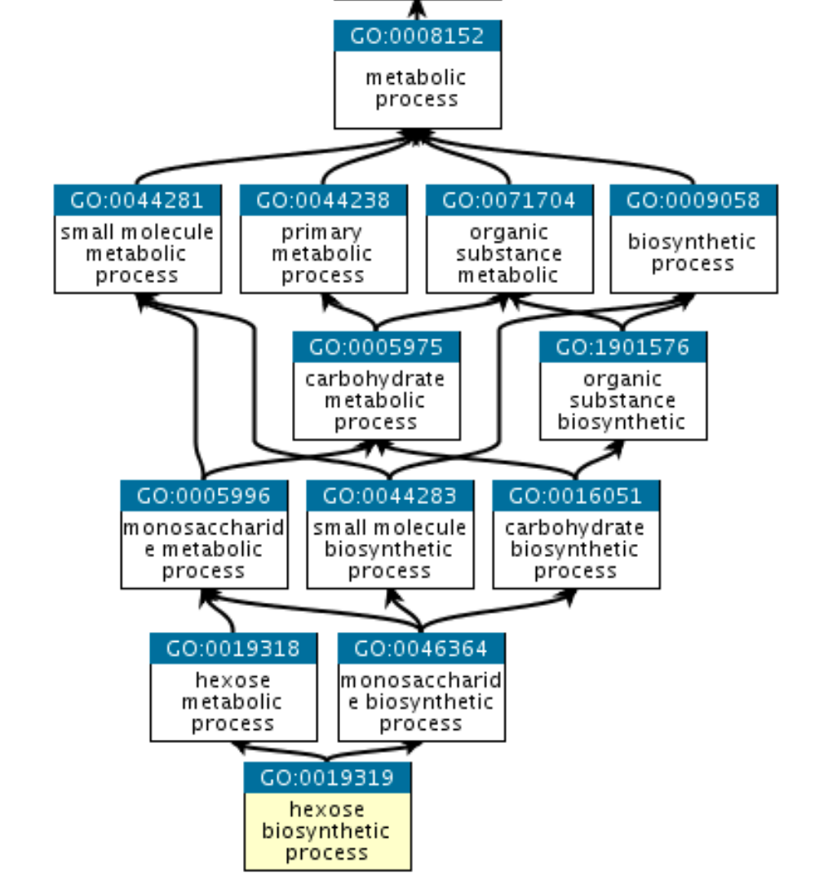
GO Graph
GO terms are organized as a directed acyclic graph
Each term has defined relationships with other terms in the same or, sometimes, another domain
Is species neutral; can be used across the tree of life
http://geneontology.org/docs/ontology-documentation/

Slide 8
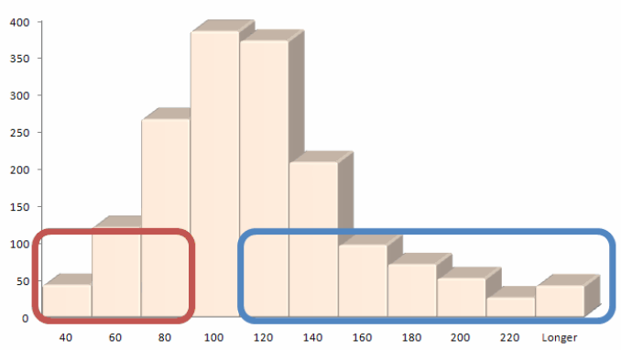
Distribution of Locus Lengths
Specific GO terms contain genes with shorter/longer locus lengths:
Distribution of Average Locus Length in GO Terms
Nervous system development
Regulation of cell differentiation
G-protein signaling
Number of GO Terms
Nucleosome
Electron transport
rRNA processing
Average Locus Length (kb)
Taher, L. & Ovcharenko, I. Variable locus length in the human genome leads to ascertainment bias in functional inference for non-coding elements.Bioinformatics 25, 578-584 (2009).

Slide 9
Gene Set Enrichment Analysis (GSEA)
GSEA uses existing gene sets to test whether the majority of genes fall at the extremes of the set
Gene sets include GO, but also other sets such as MSigDB
http://software.broadinstitute.org/gsea/msigdb/collections.jsp
In GSEA, you first rank and weigh all the genes in an individual set
E.g., for RNA-seq you might rank by RPKM and weigh by fold change
Then, from top down, you generate an enrichment score by adding (or subtracting) points based on those weights.
A high score at the end indicates clustering at the extremes and thus enriched for this particular gene set pathway

Slide 10
GSEA (formally)
GSEA:
Rank genes by expression
Compute cumulative sum over ranked genes as:
+1/(gene set size) when gene is in set
-1/(remaining genes) otherwise
Enrichment = maximum deviation from zero
Is this enrichment significant?
Permutation test:
For n permutations:
select random gene set of the same size as the existing gene set
calculate enrichment score for this gene set
p-value <= #permutations with higher score than enrichment score/ n

Slide 11
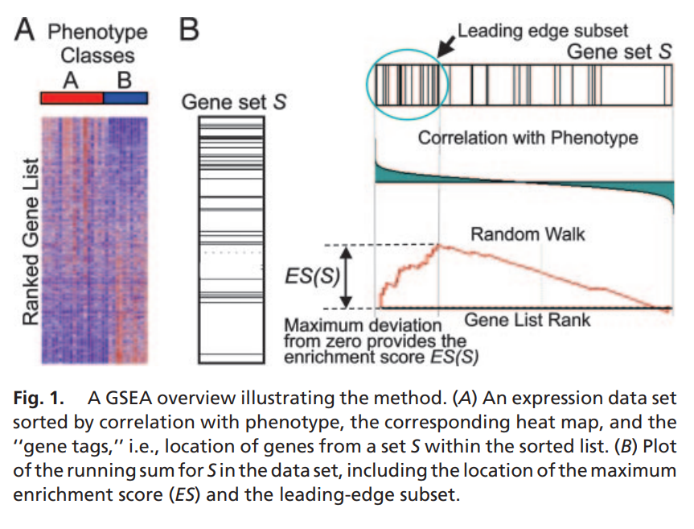
Generating a Gene List Rank
Subramanian et al, 2005. PNAS

Slide 12
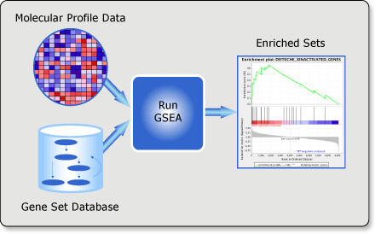
GSEA at the Broad Institute
http://software.broadinstitute.org/gsea/index.jsp

Slide 13
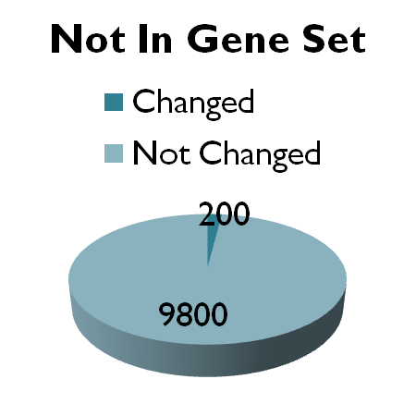
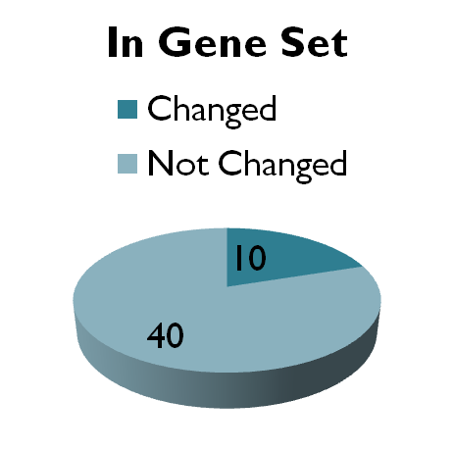
Enrichment testing – an alternative approach
Fisher’s Exact Test
 | In Gene Set | Not In Gene Set
Changed | 10 | 200
Not Changed | 40 | 9800

Slide 14
Fisher’s exact test
Uses hypergeometric distribution to calculate probability:
# signif
# not signif
# in category
A 10 | B 40
C 200 | D 9800
# not in category
Strengths:
Computationally efficient
Intuitive interpretation
All you need is gene list to perform test
Limitations:
Different significance cutoffs may lead to conflicting results
Loss of information due to discretizing the data
Several online tools use this or a similar test, including DAVID.

Slide 15
Adjust the resulting p-values
We often test hundreds or thousands of gene sets. So, just like with gene expression analysis, we need to adjust the p-values for multiple testing
A p-value<0.05 cutoff will result in too many false positives.
False discovery rate (FDR)
Benjamini & Hochberg’s FDR
Permutations (e.g., GSEA)

Slide 16
Decisions to make when inputting a list of genes
Choosing the gene list to input
Can use a combination of p-value and fold change
Generally, a relaxed cutoff is better, but depends on power of experiment
Generally ~150-800 genes works best (too few genes→ not enough statistical power; too many genes → signal becomes diffuse)
Up-regulated, down-regulated, or both?
Depends on the dataset as to what works best
Probably want to test up- and down-regulated genes separately, and also test a combined list

Slide 17
Tools for enrichment testing for deep sequencing data
ChIP-seq
ChIP-Enrich – for datasets with sharp peaks
Broad-Enrich – for broad genomic regions
Seq2pathway- new R/Bioconductor package
Genomic Regions Enrichment of Annotations Tool (GREAT) – (Warning: has very inflated type 1 error)
RNA-seq
GOseq
DAVID – still works relatively well, even though developed for microarray data
RNA-Enrich (on LRpath website)

